Slide 1
SOC. 8:
Crime and Deviance
Instructor: Dr. Linda McAllister

Slide 2
Why do people break rules?

Slide 3
Sociology is the systematic study of human societies. This study includes both the institutions that structure and organize human group life as well as the interpersonal exchanges between individuals.
Notes:
Course definition of sociology

Slide 4
The Scope of Sociological Inquiry:
Macrolevel: way of examining human life that focuses on the broad social forces and structural features of a society that exist above the level of individual people
Microlevel: way of examining human life that focuses on the immediate, everyday experiences of individuals
The macro and micro are interdependent

Slide 5
The Practice of Sociological Inquiry:
Observe patterns in human behavior
Develop theories to explain these observations
Conduct investigations, gather and analyze data
Assess theories based on evidence or logical arguments

Slide 6
Key Inquiry Spaces
Culture: the languages, values, beliefs, rules, behaviors, and artifacts that characterize a given collective
The Social Structure: the framework of a society that organizes and regulates social life. This includes institutions, organizations, groups, statuses and roles
Power: the ability of individuals, groups, organizations, or institutions to exercise control over other people or groups despite possible opposition

Slide 7
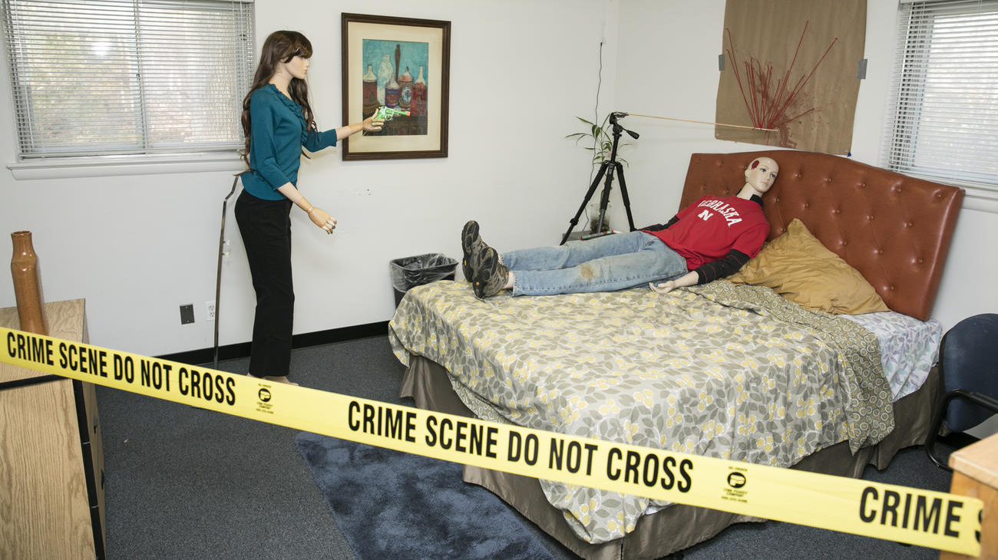
Notes:
Crime scene learning lab: Image shows a mannequin “victim”, mannequin “perpetrator” and blood spatter patterns

Slide 8
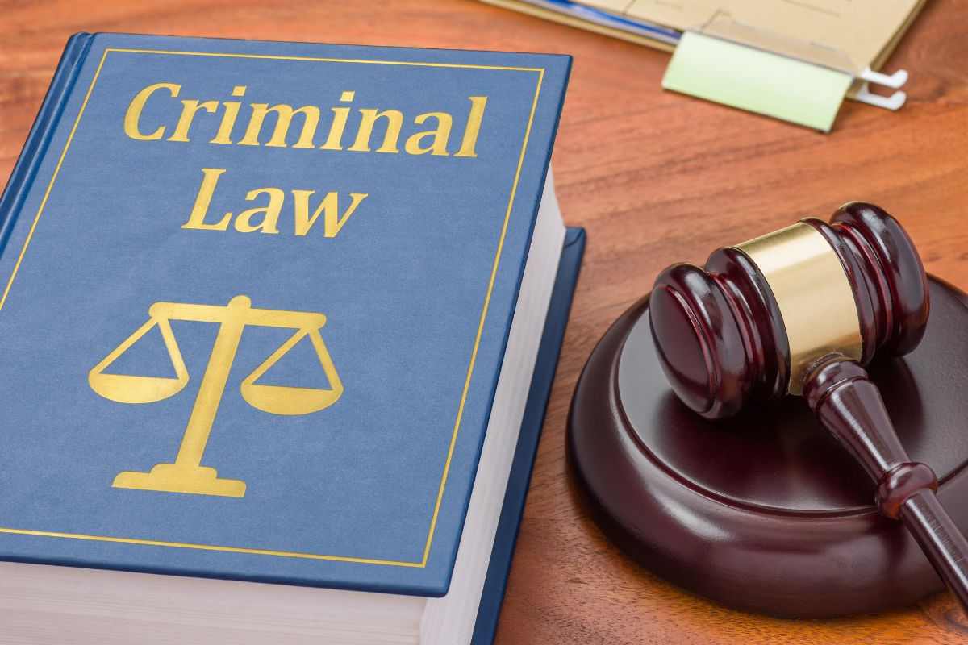
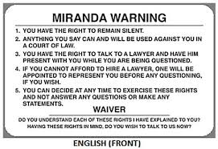
Notes:
Left image is a book of criminal codes next to a gavel. Right image is the front of a Miranda Warning card

Slide 9
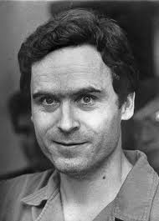
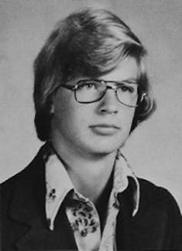
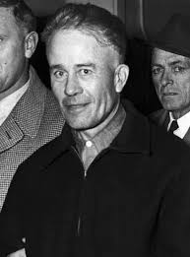
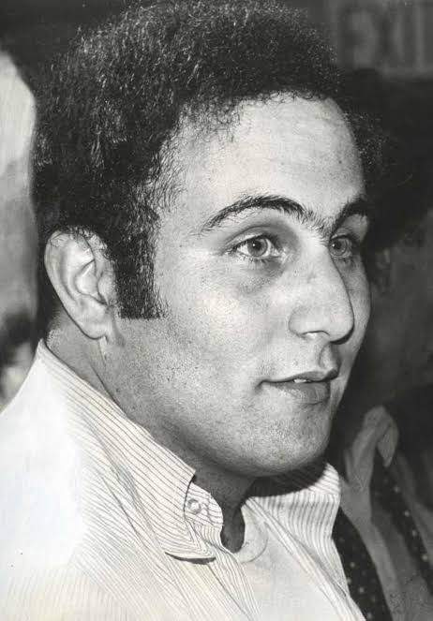
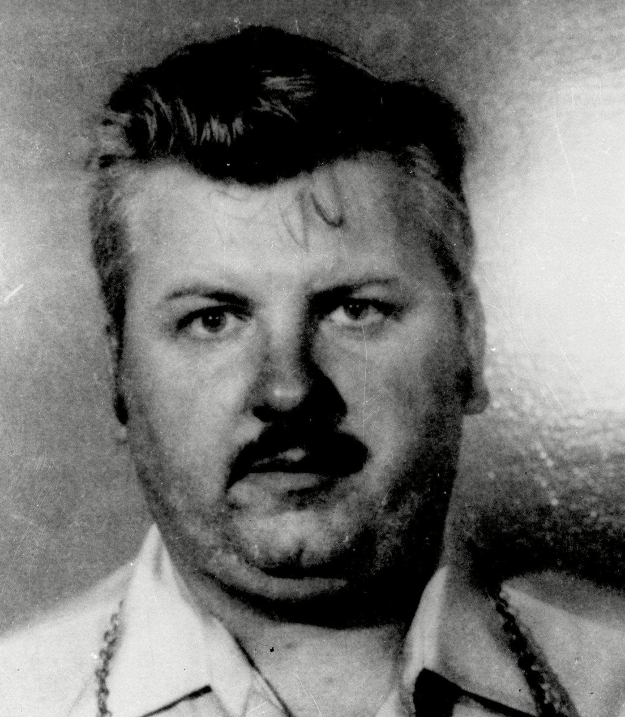
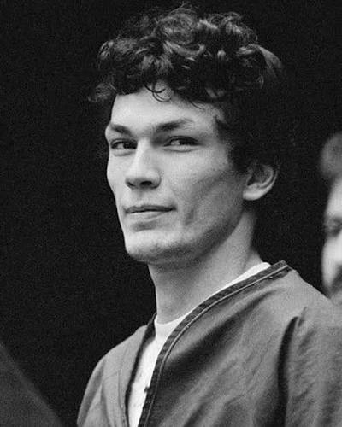
Notes:
From top L to R: Ted Bundy, Jeffrey Dahmer, Ed Gein, David Berkowitz, John Wayne Gacy , Richard Ramirez

Slide 10
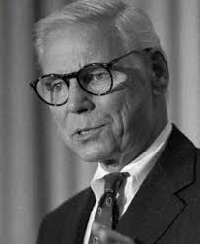
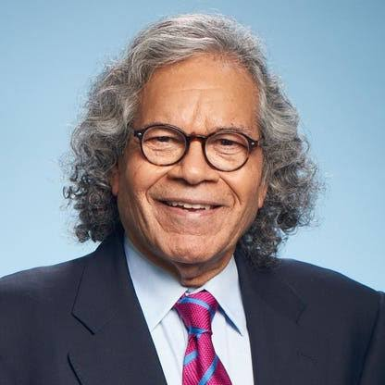
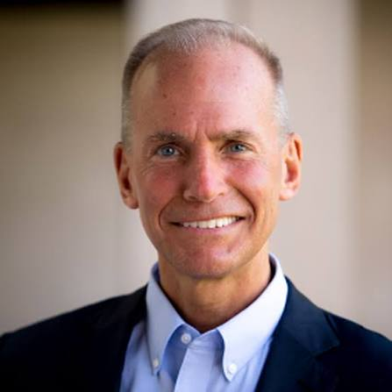
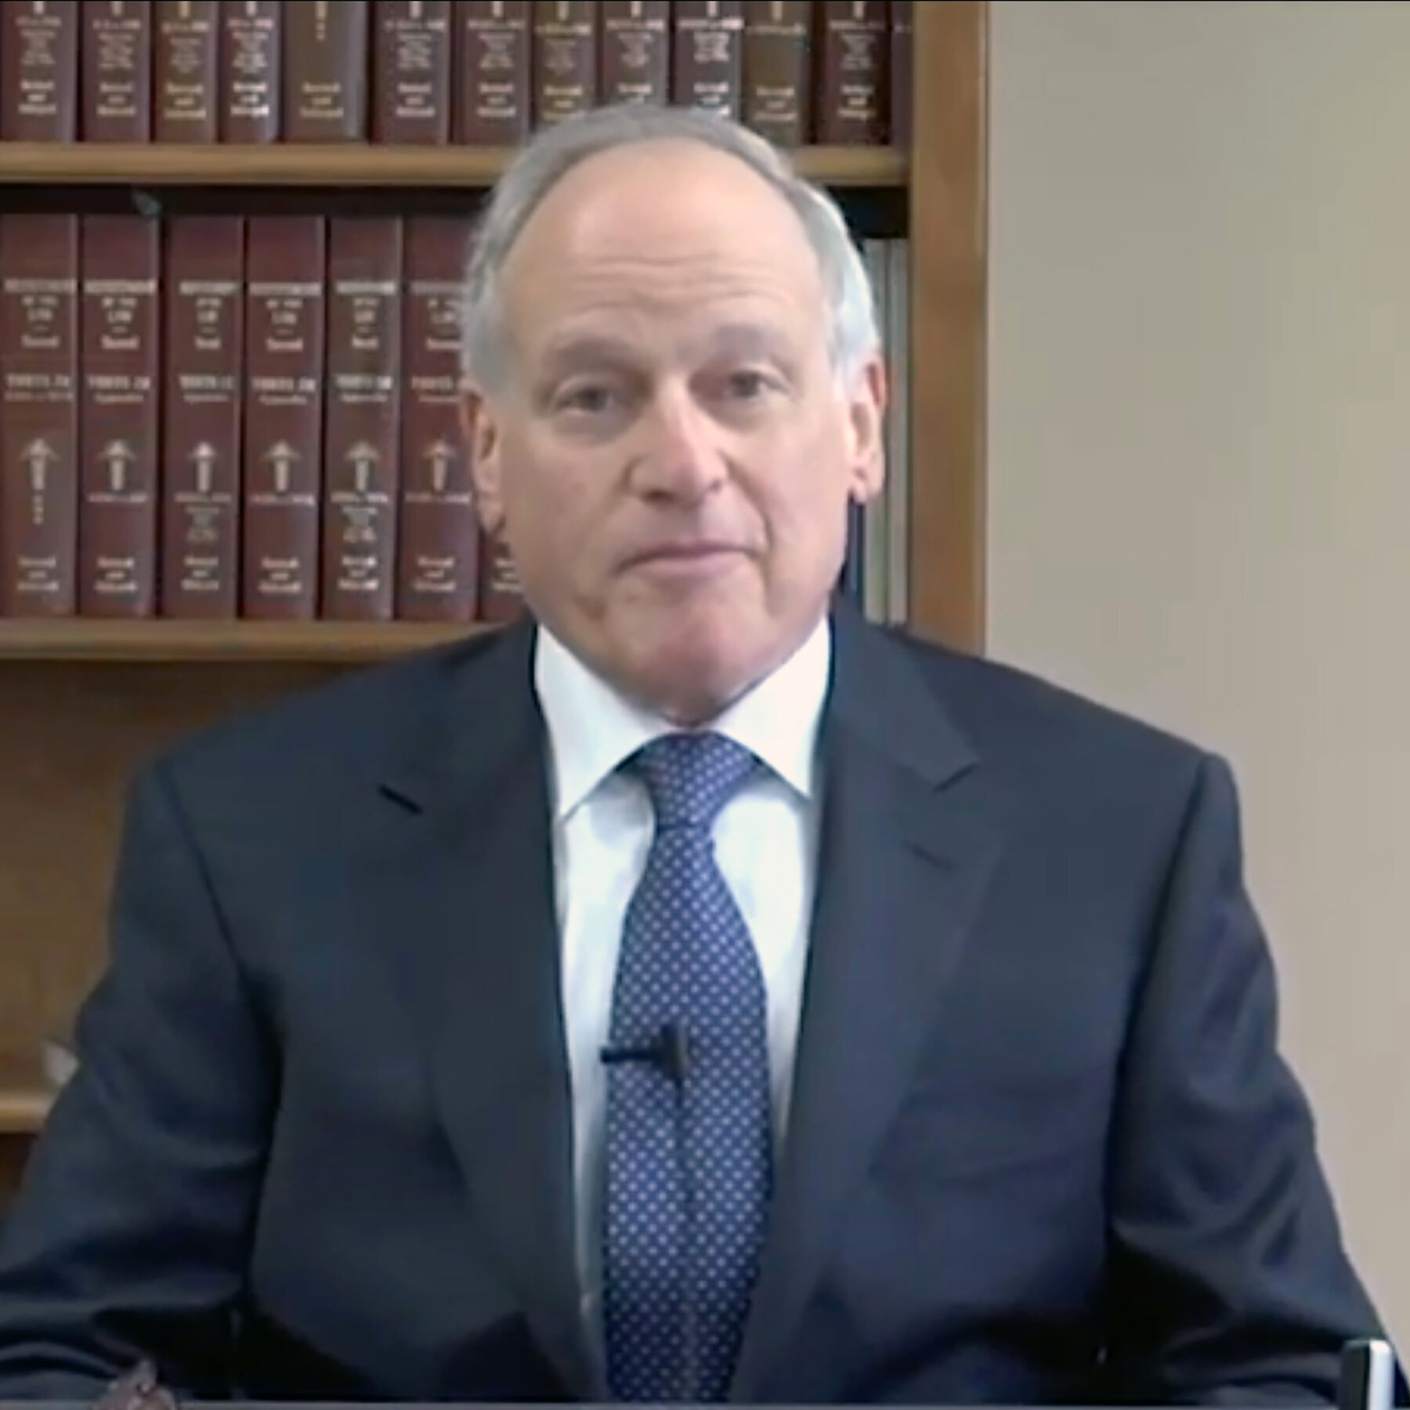
Notes:
Top L: Warren Anderson (Union Carbide), John Kapoor (Insys), Denis Muilenberg (Boeing), Richard Sackler (Purdue Pharma)

Slide 11
Defining Deviance and Crime
Deviance: any behavior, belief or characteristic that violates the social norms or expectations of a given society, provokes disapproval, and risks social control
Crime: behaviors that violate the formalized behavioral norms (laws) of a given society

Slide 12
Elements of a Sociological Understanding of Deviance
A norm, rule, or expectation must exist
  Norm: culturally defined standard of conduct
The norm, rule, or expectation must (or believed to) be broken
A social audience reacts with disapproval and social control
  Social control: range of responses a society, or members of a society, uses to address norm violations

Slide 13
ABCs of Deviance
“Attitudes”: unpopular or unconventional beliefs, ideas or opinions
“Behavior”: overt actions (or failure to act) that risks disapproval or condemnation
“Conditions”: physical characteristics or traits that risk making an individual the target of negative social reactions

Slide 14
Social control: the entire range of responses a society uses to address norm violations
Relative: varies across time and place
Contextual: depends on specific physical or social situations
Contingent: depends on factors outside of behavior, attitudes, or characteristics
Probabilistic: likely but not definitive

Slide 15
How we are not using the term deviance
As a pejorative (word of disapproval)
As statistical rarity
As an absolute

Slide 16
Additional Considerations:
Degree of Consensus
  agreement in opinion or feeling among a group of people
Direction of imposition of norms
  Structural/hierarchical or interpersonal/horizontal

Slide 17
Types of Social Control
Internal Social Control
  Socialization – the processes through which we learn how to act according to the rules and expectations of a particular culture
External Social Controls
  Sanctions: social response that rewards conforming behavior and punishes behavior that violates norms
    Informal
    Semi-formal
    Formal

Slide 18
Informal Social Control
Takes place in interpersonal interactions or mediated interactions between people or groups
Can include ridicule, reprimand, criticism, shunning, harms to reputation
Notes:
Image shows three women engaging in gossip

Slide 19
Semi-formal Social Control
Is administered by bureaucratic agencies outside of the criminal legal system, another term is “professional” control
Can include fines, monitoring, detentions, suspensions, mandatory evaluations, treatments, performance reviews

Slide 20
Formal Social Control
Takes place through interactions with the agents and organizations of the criminal justice system
Can include fines, monitoring, probation, imprisonment, court remanded treatments, restitution

Slide 21
Normative Approach
Deviance is the violation of widely held social norms
Focus is on rule breakers
Norms have degrees of seriousness
Deviance is a concern for social stability

Slide 22
Reactive Approach
Deviance is a condition or action that receives condemnation or punishment.
Focus is on rule makers
Focus on “deviant” as an identity status
Connects deviance to social stratification
Deviance identification as a process of social control

Slide 23
Consensus vs. Conflict Model of Social Order
Consensus Model
Conflict Model
Collectives are defined by their social agreements
Consensus is possible
Laws represent agreed upon social values
Disruptions or challenges to consensus must be addressed as a matter of stability
Punishment is a functional need
Collectives are engaged in constant struggles over control and resources
The law has its origin in the interests of a few
What deviant is defined by groups in power
Deviance must be managed to maintain status quo
Punishment benefits some at the expense of others

